Slide 1
DSC 640 – Exercise 4.2
Ramsey king

Slide 2
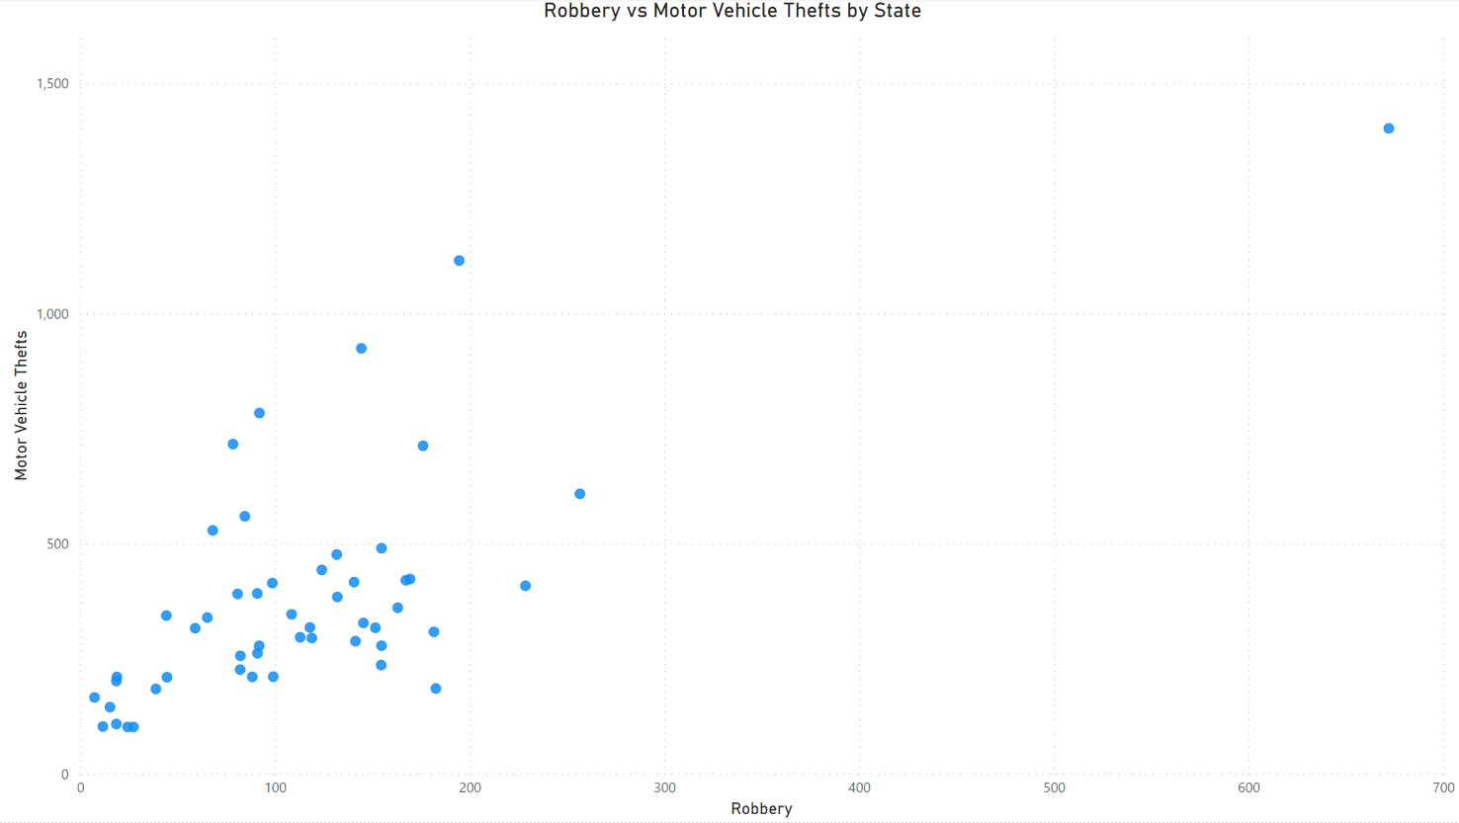
Power bi – scatterplot

Slide 3
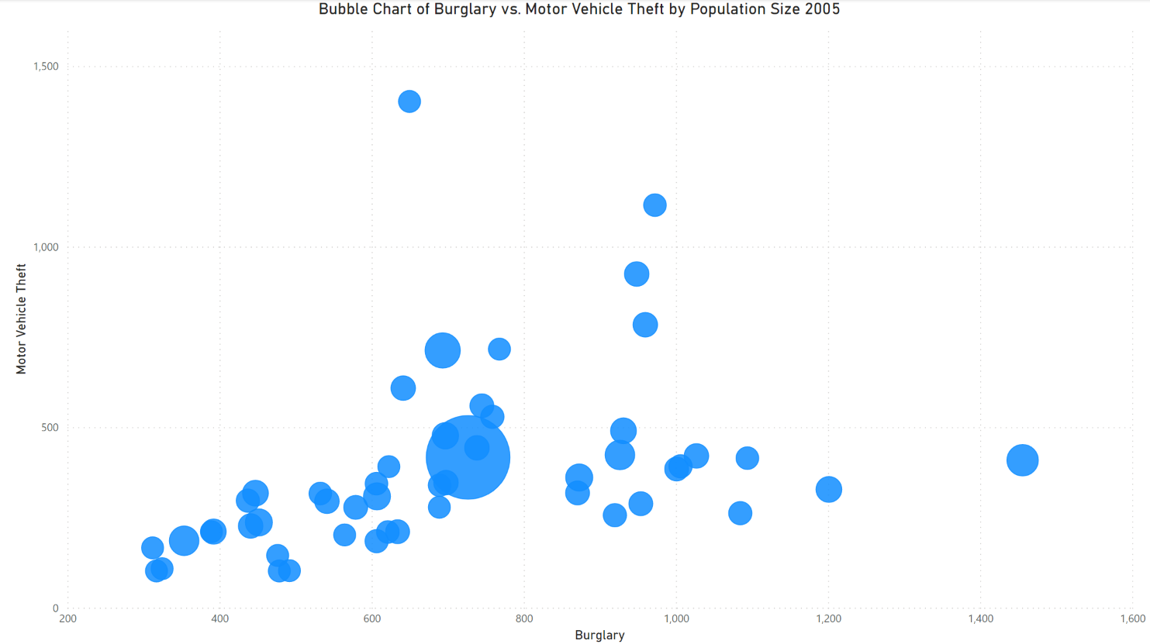
Power bi – bubble chart

Slide 4
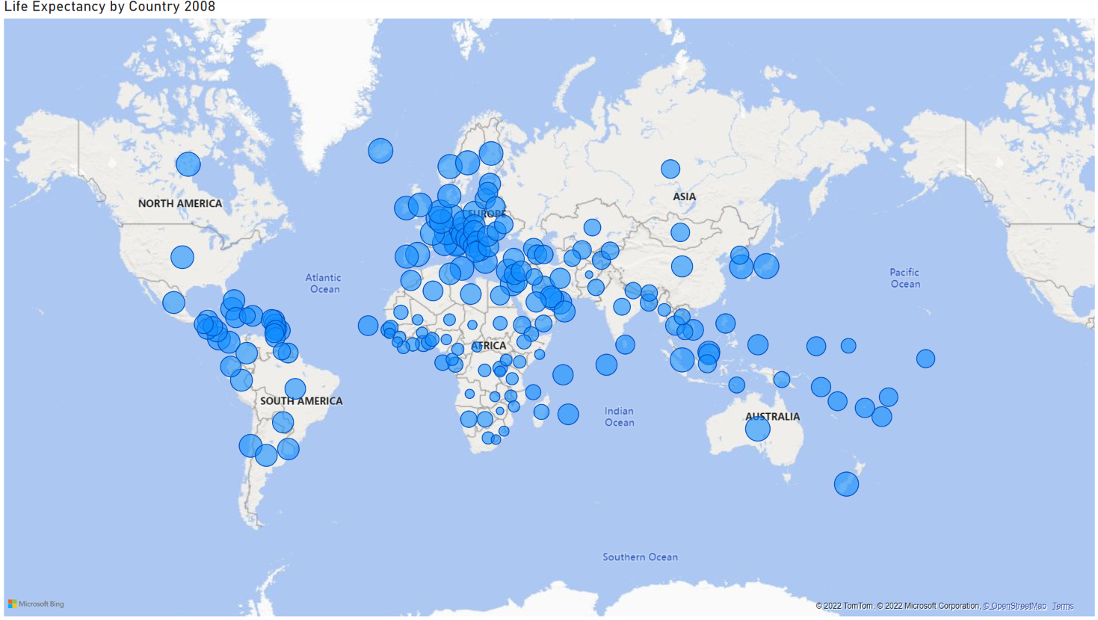
Power bi – density map

Slide 5
r– scatterplot

Slide 6
R – bubble chart

Slide 7
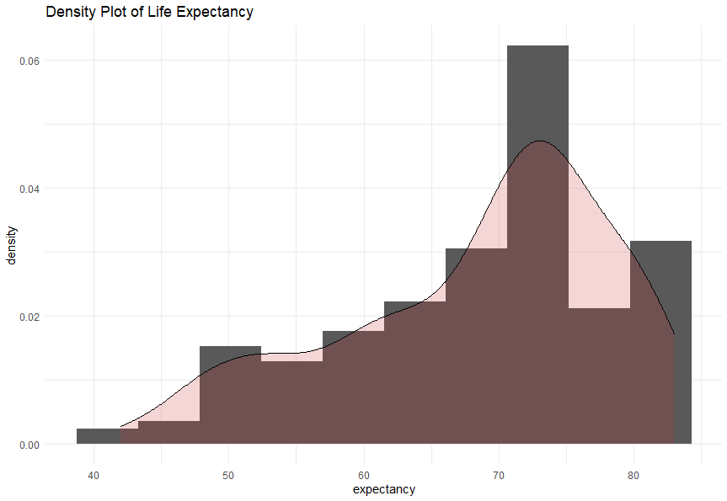
R – density plot

Slide 8
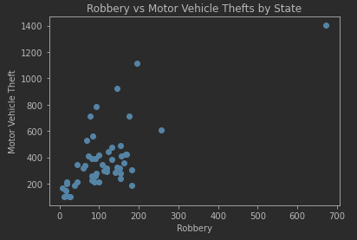
Python – scatterplot

Slide 9
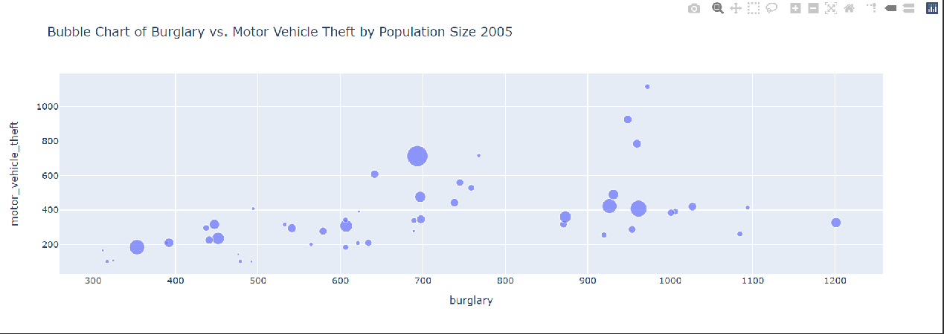
Python – bubble chart

Slide 10
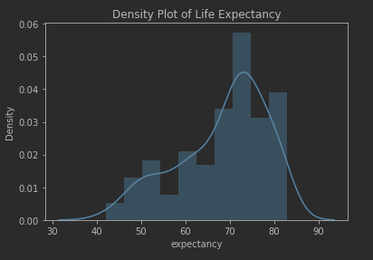
Python – density plot

